Slide 1
Contemporary Issues in Education
Corporal Punishment in Schools

Slide 2
INTASC Standard
INTASC Standard, Description and Rationale
Standard #9: Professional Learning and Ethical Practice
The teacher engages in ongoing professional learning and uses evidence to continually evaluate his/her practice, particularly the effects of his/her choices and actions on others (learners, families, other professionals, and the community), and adapts practice to meet the needs of each learner.
Name of Artifact: Contemporary Issue Project (Corporal Punishment in Schools)
Date: November 12, 2013
Course: EDUC 101
Brief Description: For this assignment we (Taylor and Maci) did a PowerPoint on Corporal Punishment in School. This PowerPoint highlights the pros and cons of corporal punishment in schools as well as some minor facts.
Rationale: To document our understanding of Standard #9: Professional Learning and Ethical Practice, we choose our Contemporary Issue Project (Corporal Punishment in Schools). We believed that this assignment allowed us to be able to do some research on what we personally believe

Slide 3
Corporal Punishment
What is it?

Slide 4
Spare the Rod Spoil the Child
Nineteenth Century Education

Slide 5
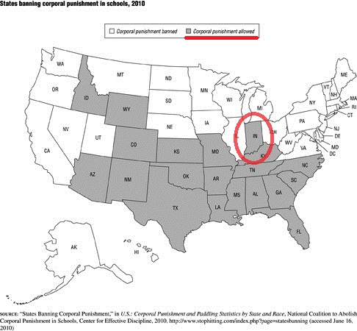

Slide 6
Fun Facts:
Corporal Punishment: very broad, can very from forced labor to torture
Indiana is one of 20 states where spanking remains an option for student discipline (McCollum)
More private religious schools still incorporate corporal punishment
21 still allow, while twenty-eight states plus the District of Columbia have banned the practice (Martin)
Usually used as last resort for punishment
Indiana: corporal punishment is governed by the type of offense and needs to have consent from parents (McCollum)

Slide 7
Pros and Cons of Punishment
Pros
Cons
Less Suspensions
Teaches Discipline/ Helps With Behavior Malfunctions
Some children want it
Promotes Violence
Low Academic Achievement
Causes Injuries

Slide 8
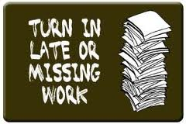
Pro: Less Suspensions
Could be used as an alternative to not suspend.
No work missed
Child doesn’t miss out on activities

Slide 9
Pro: Teaches Discipline/ Helps Behavior Malfunction
Every decision= consequence
In some cases…

Slide 10
Pro: Some Children Want It
According to a broadcast on ABC News aired March 16, 2012, Diane Sawyer interviewed a 13 year old honor roll student. The 13 year old boy told reporters that he was spanked by his teacher for failing a science test.

Slide 11
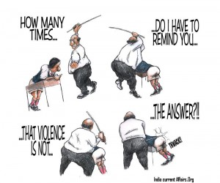
Cons: Promotes Violence
It perpetuates a cycle of child abuse. It teaches children that hitting someone smaller and weaker when angry is acceptable.

Slide 12
Cons: Low Academic Achievement

Slide 13
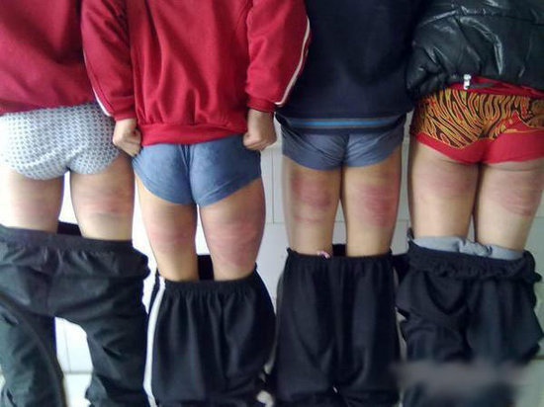
Cons: Causes Injuries
Bruises and broken bones are not unusual. Children’s deaths have occurred in the U.S. due to school corporal punishment.

Slide 14
Discussion Question #1
Should corporal punishment be tolerated anywhere, rather at home or in schools?? What's the difference?

Slide 16
Discussion Question #2
Should corporal punishment not be tolerated in schools, even religious based institutes?

Slide 17
References
"Center for Effective Discipline, Inc." Gale Opposing Viewpoints in Context. Detroit: Gale, 2014. Opposing Viewpoints in Context. Web. 11 Nov. 2013
McCollum, Carmen. "Some area schools still spanks as disicipline." (22 January 2012). Published: 2013 niwitimes.com http://www.nwitimes.com/news/ local/lake/gary/some-area-schools-still-spank-as- discipline/article_ddee089c-955b-5616-ba78- 5b2c0dc19e9d.html 11 November 2013.
MICHEL, MARTIN. "To Spank Or Not To Spank? Moms Discuss Discipline." Tell Me More (NPR) (n.d.): Newspaper Source. Web. 11 Nov. 2013.
"States banning corporal punishment in schools,(2010)." Child Abuse and Domestic Violence. Melissa J. Doak. 2011 ed. Detroit: Gale, 2010. Information Plus Reference Series. Opposing Viewpoints in Context. Web. 9 Nov. 2013.

Slide 18
Maci Pryor & Taylor Haney
Presentation Presented by…

